Slide 1
React JS
(an intrOduction)
Lecture-1

Slide 2
Today’s Agenda
What You Should Know Before Joining This Course ?
What Is React ?
What Are SPA’s ?
How React Helps In SPA ?
Is React A Framework OR Library ?

Slide 3
What You Should Know ?
To start learning React JS, you must have knowledge of three key front end technologies :
HTML
CSS
Java Script :Specially DOM and the ES6 part

Slide 4
What Is React JS ?
React is
a JavaScript library — probably one of the most popular.
an open-source project created by Facebook.
used to build user interfaces (UI) on the front end.
used to build single-page applications(SPAs).

Slide 5
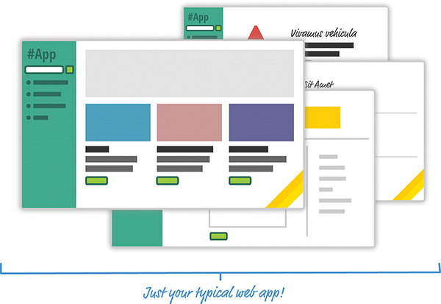
What Problem React Solves?
To get the answer to the above question , have a look at the following web app which is an e-commerce app:

Slide 6
What Problem React Solves?
As with any app of this sort, we have our usual set of pages revolving around a home page, a search results page, a details page, and so on.
In the upcoming slides, let’s look at the two approaches we have for building this app.

Slide 7
The Old Approach:
Multi Page Design
If we had to build this app a few years ago, we might have taken an approach that involved multiple, individual pages.
The flow would have looked something as shown in next slide

Slide 8
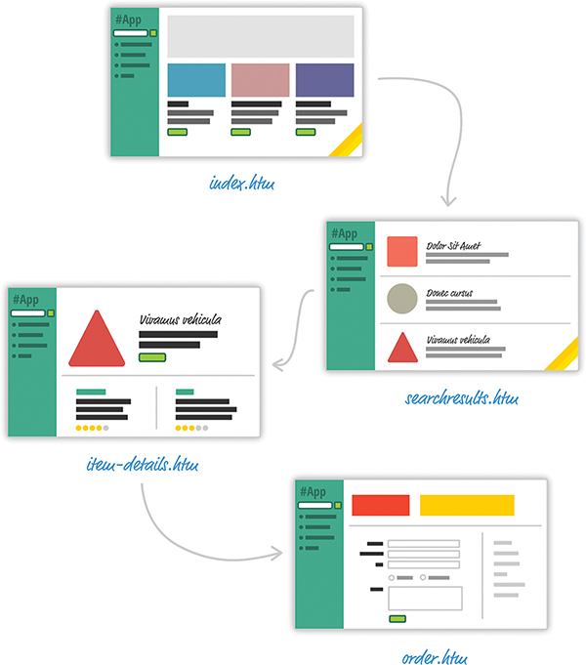
The Old Approach:
Multi Page Design

Slide 9
The Old Approach:
Multi Page Design
For almost every action that changes what the browser displays, the web app navigates us to a whole different page.
This is a big deal, as it will force the user to wait and the users will see the pages as they get downloaded and redrawn.

Slide 10
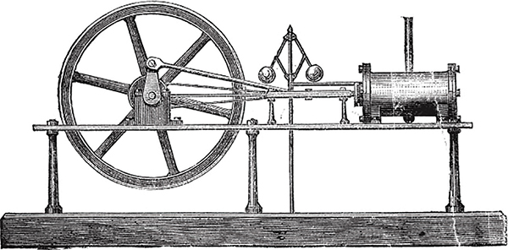
The Old Approach:
Multi Page Design
These days, going with a web app model that requires navigating between individual pages is outdated.
Its just like having a steam engine in today’s era:

Slide 11
The New Approach:
Single Page Design
Instead, the modern apps in today’s era follow single-page app (SPA) model.
In this world, the different views of our app are loaded and unloaded into the same page itself.
It means we never navigate to different pages or ever even reload a page.

Slide 12
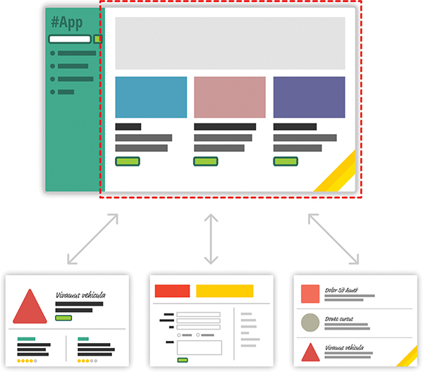
The New Approach:
Single Page Design

Slide 13
The New Approach:
Single Page Design
As users interact with our app, we replace the contents of the dotted red region with the data and HTML that matches what the user is trying to do.
The end result is a much more smooth experience.

Slide 14
Real World Examples Of SPA
If you’ve ever used popular web apps like Gmail, Instagram, NetFlix, or Youtube, you’ve used a single-page app.
In all those apps, the content gets dynamically displayed without requiring you to refresh or navigate to a different page.

Slide 15
Challenges In SPA
When building single-page apps, we’ll encounter two major issues at some point:
Handling Lot Of DOM Manipulation
Keeping Data In Sync With The UI

Slide 16
Challenges In SPA
Handling Lot Of DOM Manipulation
In a SPA , lot of DOM manipulation takes place since it is the primary way we are able to react to user actions and display new content.
And manually querying elements, adding children , removing subtrees, and performing other DOM operations is one of the slowest things we can do in our browser

Slide 17
Challenges In SPA
Keeping Data In Sync With The UI
In a SPA , bulk of our time will go in deciding how to sync data with the UI
For example, if a user loads new content, shall we explicitly clear out the search field?
Shall we keep the active tab on a navigation element still visible?
Which elements shall we keep on the page, and which shall we destroy?

Slide 18
Facebook Comes To Our Rescue
Facebook decided to solve all these issues for front end developers .
They released a library called React to not only address these shortcomings, but also change how we think about building single-page apps.

Slide 19
React Advantages
Lightning-Fast DOM Manipulation
Because DOM modifications are really slow, we never modify the DOM directly using React.
Instead, we modify an in-memory virtual DOM.
Manipulating this virtual DOM is extremely fast, and React takes care of updating the real DOM when the time is right.

Slide 20
React Advantages
Automatic UI State Management
With single-page apps, keeping track of our UI and maintaining state is hard and also very time consuming.
With React, we need to worry about only one thing: the final state of our UI.
React takes care of everything else.

Slide 21
React Advantages
APIs to Create Truly Composable UI
In React everything is a Component
Instead of treating the visual elements in our app as one monolithic chunk, React encourages us to break our visual elements into smaller and smaller components
Many of React’s core APIs revolve around making it easier to create smaller visual components that can later be composed with other visual components to make larger and more complex visual components

Slide 22
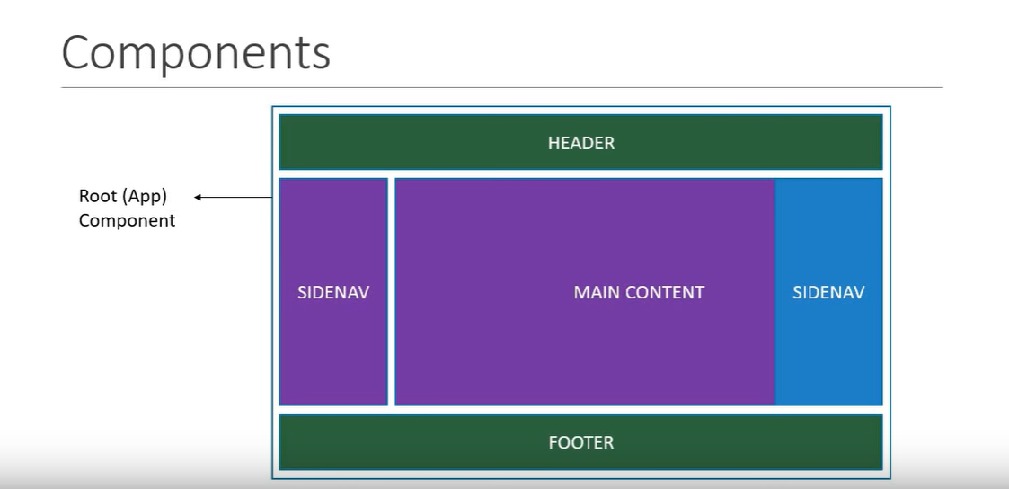
React Advantages

Slide 23
React Advantages
C-Lang
C++
Java
Python
<div>
C-Lang
Code 2
Code 3
</div>
<div>
C++
Code 2
Code 3
</div>
<div>
Java
Code 2
Code 3
</div>
<div>
Python
Code 2
Code 3
</div>
Course
<div>
Name
Code 2
Code 3
</div>
C-Lang
C++
Java
Python
<customer name=‘C-Lang’ />
<customer name=‘C++’ />
<customer name=‘Java’ />
<customer name=‘Python’ />

Slide 24
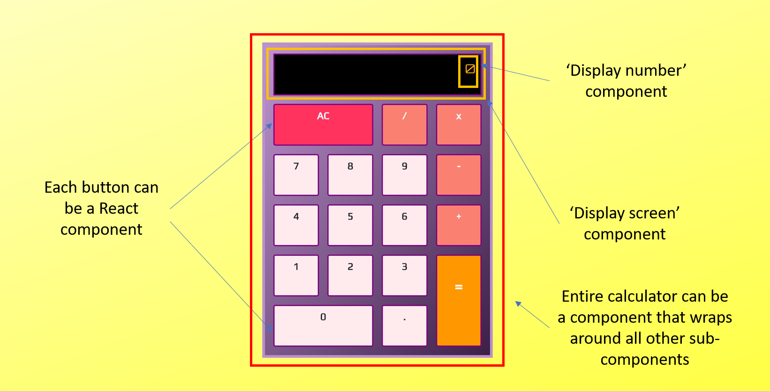
React Advantages

Slide 25
Is React A Library or Framework ?
In some quarters, React is often called a framework because of its behaviour and capabilities.
But technically, it is a library.
Unlike some other frameworks like Angular or Ember, we’ll often need to use more libraries with React to form any solution.

Slide 26
Is React A Library or Framework ?
Let's look at a project like Angular, which shares the same purpose as React (to create single-page web apps).
What sets it apart is the fact that when we set up an Angular project, it is bootstrapped with nearly every single thing that well need to make a complete, large-scale app.

Slide 27
Is React A Library or Framework ?
This includes built-in tools for common tasks like creating forms, running automated tests, making network requests, and much more.
In short, everything that we need to make a complete application is included in our Angular project when it's generated.
But that is not the case with React.

Slide 28
Is React A Library or Framework ?
React is a JavaScript library for building user interfaces.
It deals with the views and lets us choose the rest of our front-end architecture.
That means, in order to build complete React applications, we will need to choose other libraries and tools on our own.

Slide 29
React Is Customizable
For example : For a form library, we have to decide whether we want to use the package React Hook Form or Formik.
These are both React-specific form libraries to add important features to our forms like validation.

Slide 30
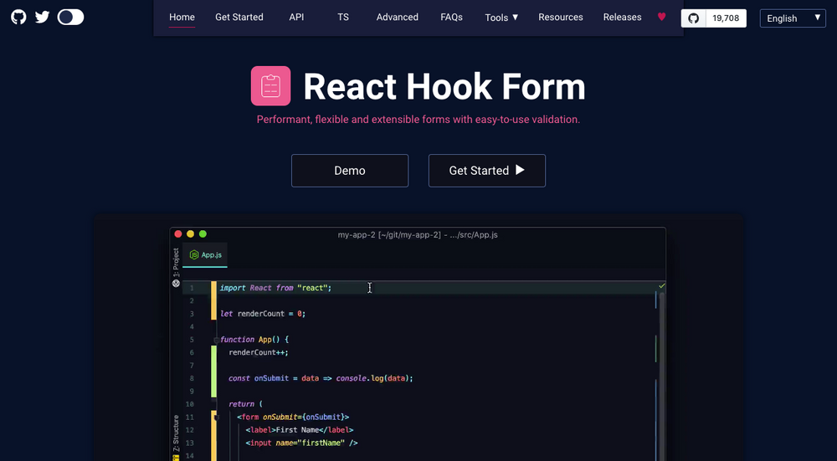
React Hook Forms

Slide 31
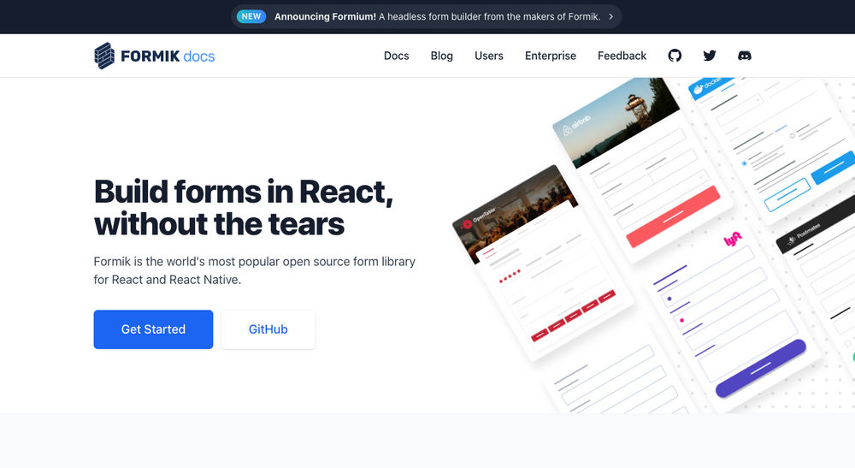
Formik Library

Slide 32
React Is Customizable
Similarly for making AJAX requests in React , we might choose between the Fetch API or Axios or plain AJAX.
While in Angular , we have only one option for AJAX and that is using Angular’s service called $http.

Slide 33

Version History
Facebook created React.js in 2011 for their own use under the leadership of Jordan Walke

Slide 34
Version History
In 2013, Facebook made React an open-source library and released the version 0.3.0
In 2015,the OTT platform giant Netflix announced that it will use React for its app.
In 2016, with version 15, React became more stable.
As of now its current latest version is 18.0.0 , released on 8th March,2022 and it’s latest update is 18.2.0 launched on 14th June, 2022
Today, React is used by many Fortune 500 companies and Facebook has full-time React development staff.

Slide 35
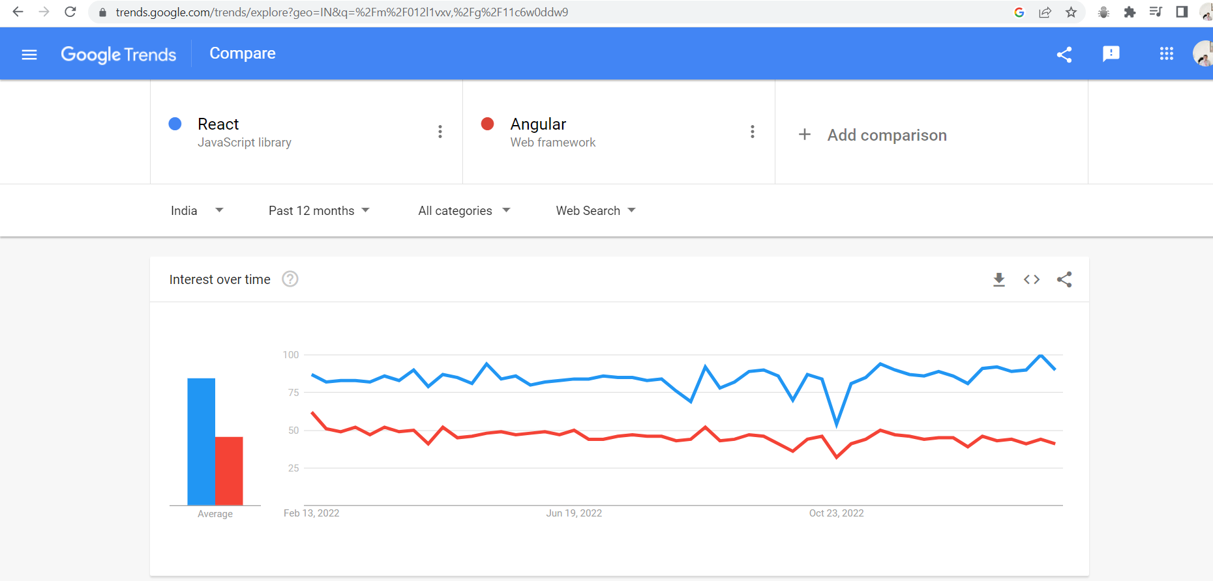
Where React Stands Today ?

Slide 36
Syllabus
React Basics | Advance Topics
React Basics & Working With Components | Working With Local Storage In React
React State & Working With Events | React Hooks
Rendering Lists & Conditional Content | Context
Understanding JSX | Fragment
Stateless Functional Components | Ref
Web Pack | Redesigning The Todo App
Using Create React App | Code Optimization In React
Styling React | Sending HTTP Request
React Design Principles | Working With Forms And User Input

Slide 37
Class Schedule
Monday, Wednesday And Friday
The next class is on Monday, 13th Feb @ 9:00 P.M.
Topic : Developing First React App
For Any Query : Please call at 9826686245, 7870554215

Slide 38
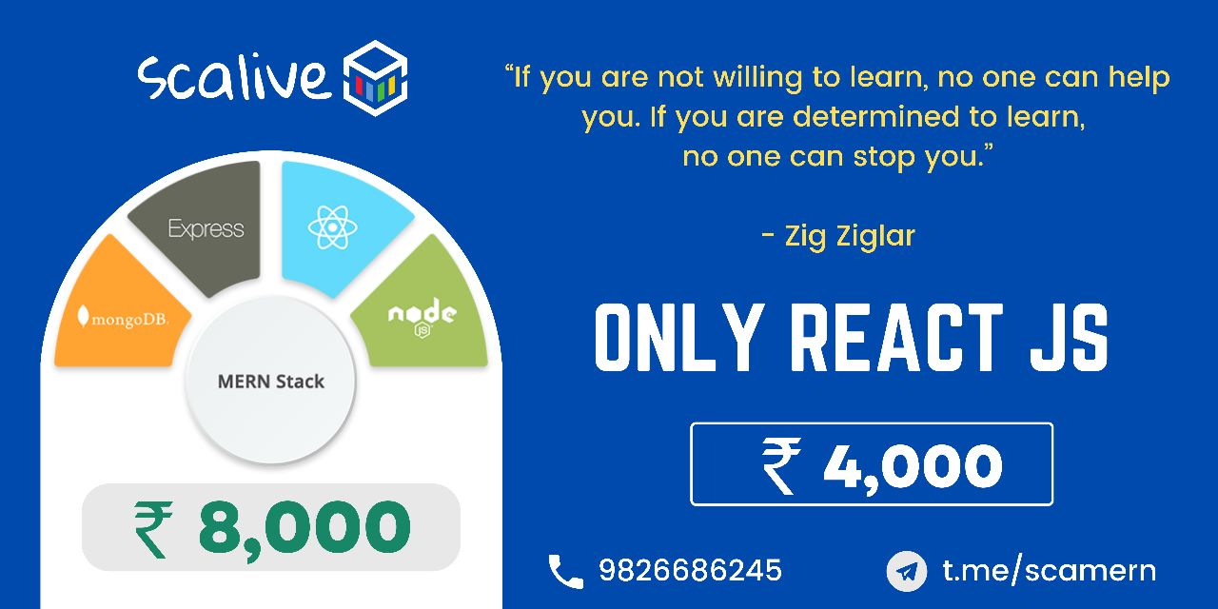
Fee Structure

